Slide 1
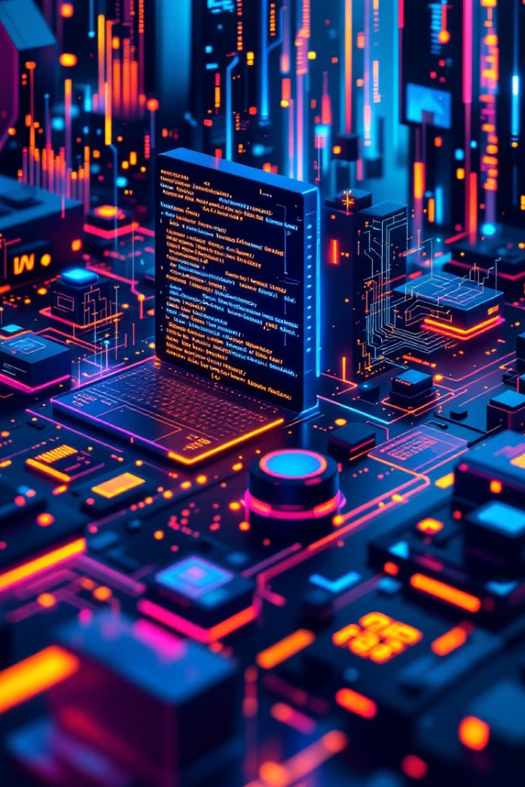
The Evolution of Programming Languages
A journey through the history and future of coding.
By Muhammad Musawar Ali Shah

Slide 2
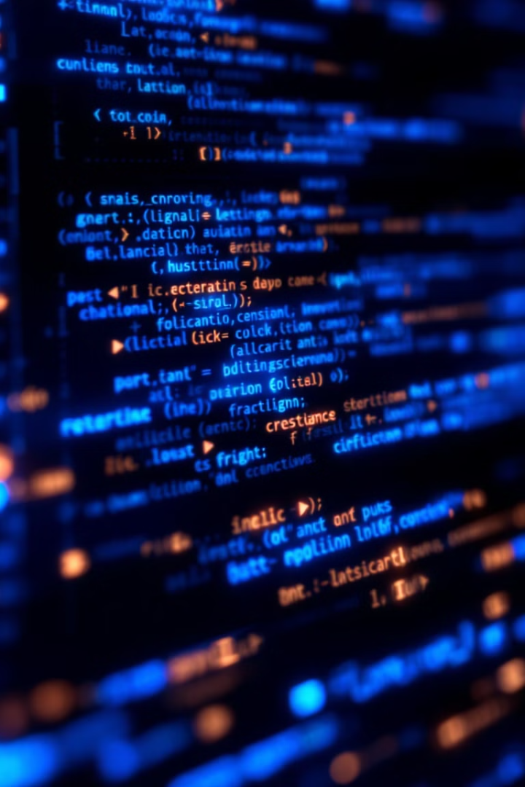
Why Programming Languages Matter
1
Backbone of Technology
2
Problem Solvers
They've evolved to solve problems and improve efficiency.
Programming languages are the backbone of technology.
3
Coding Accessibility
They make coding more accessible.
Fun Fact: There are over 700 programming languages in the world!

Slide 3
Timeline of Programming Languages
1st Gen: Machine Code (1940s-50s)
1
ENIAC programming
2
2nd Gen: Assembly (1950s)
IBM 650 Assembly
3rd Gen: High-level (1950s-70s)
3
FORTRAN, COBOL
4
4th Gen: OOP (1970s-90s)
C++, Smalltalk
5th Gen: Modern Web (1990s-)
5
Java, Python, JavaScript

Slide 4
Hello, World! Code Comparison
Python
Java
C
print("Hello, World!")
System.out.println("Hello,World!“);
printf("Hello, World!");

Slide 5

Interactive Activity: Guess the Language
Code Snippet:
Hint:
This language is the backbone of web development and runs in browsers.
console.log("Hello, World!");
Answer:
JAVASCRIPT

Slide 6

Interactive Activity: Guess the Language
Code Snippet:
ANSWER:
Hint:
section .data
msg db 'Hello, World!', 0xa
len equ $ - msg
section .text
global _start
_start:
mov edx, len
mov ecx, msg
mov ebx, 1
mov eax, 4
int 0x80
mov eax, 1
int 0x80
This is a low-level language that interacts directly with hardware
Assembly(x86)

Slide 7
Interactive Activity: Guess the Language
Code Snippet:
ANSWER:
Hint:
using System;
class Program {
static void Main() {
Console.WriteLine("Hello, World!");
}
}
Developed by Microsoft, commonly used for .NET applications.
C#

Slide 8
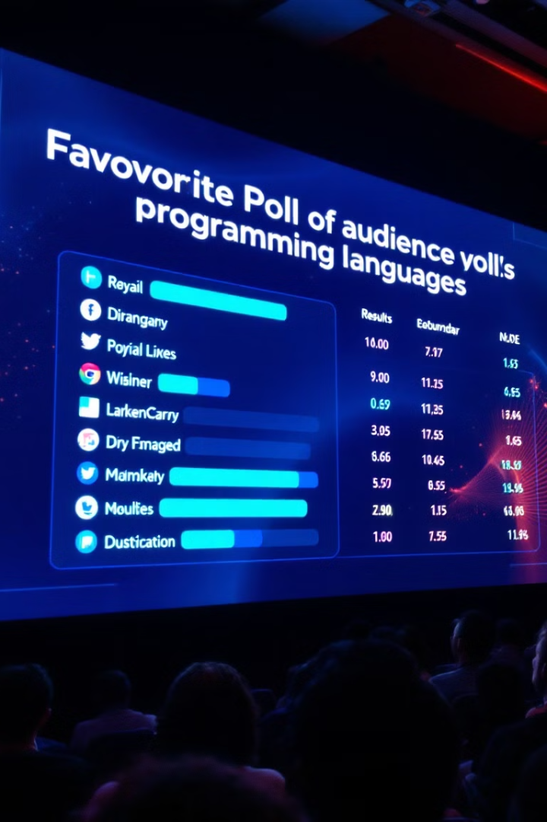
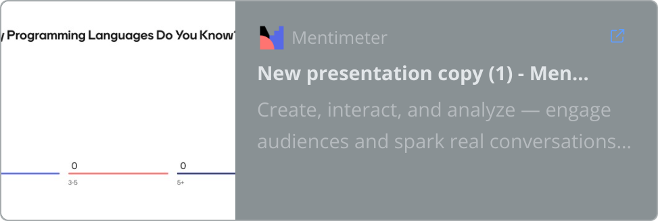
Audience Poll: Favorite Programming Language

Slide 9




The Future of Programming
AI-Assisted Coding
No-Code/Low-Code Platforms
Quantum Programming
GitHub Copilot/ Cursor.ai
Q#
Bubble, Webflow

Slide 10

THANKYOU!!

